Slide 1
Environmental Protection Expenditures Accounting in Russian Federation within SEEA
Index of environmental protection expenditures and physical volume indicators according to the recommendations of OECD/Eurostat,
April 9-10, 2019, Moscow
Georgy Fomenko, Doctor of Science in Geography
Konstantin Loshadkin, PhD in Geography
Marina Fomenko, PhD in Geography
Elena Arabova

Slide 2
Experience of Cadaster Institute
Establishment of Cadaster Institute within the Ministry of Environment of Russia as organization for accounting and assessment of natural resources and environmental assets
Projects for implementation of the SEEA methodology for solving problems of environmental and natural resource management
Development of SEEA methodology in the Russian Federation
Development of methodology for building a System of economic environmental accounts
1. Recommendations for the development of integrated territory inventories of natural resources (1993)
2. All-Russian meetings on natural resources accounting and assessment (1992, 1994)
3. Pioneering economic assessments of natural resources in the Russian Federation was carried out for Danilovsky municipal district (1997) and Yaroslavl region (1999)
4. SEEA matrix for Yaroslavl region on environmental protection expenditures accounting (1999)
1. FEDERAL LEVEL
1.1 Natural capital assessment for the Russian Federation (2009)
1.2 Assessment of ecosystem services provided by the system of federal protected areas of the Russian Federation (2010 and 2015)
2. LEVEL OF SUBJECTS
2.1 Natural capital assessment for 5 subjects of the Russian Federation (1999 — 2005)
2.2 Ecosystem services assessment in the territory of Yaroslavl region (2017)
2.3 Economic assessment of hunting resources of Tomsk region within SEEA (2012)
2.4 Software “Natural capital” (2005)
3. MUNICIPAL LEVEL
3.1 Assessment of natural resources and ecosystem services in municipalities (10 projects, 1997-2017)
3.2 Ecosystem Services Assessment at PAs (10 projects, 1997-2013)
3.3 Software “Natural capital. Protected areas”
1. Methodology of reflection of natural resources value in the system of national accounts (SNA) (Ministry of Environment of the Russian Federation, 2009)
2. Methodological recommendations for the assessment of uncultivated biological resources at current market value (2015)
3. Scientific proposals for ensuring the collection and compilation of data for SEEA (Ministry of Environment of the Russian Federation, 2014)
4. Algorithm of biodiversity conservation in protected areas using indicators of the economic value of biodiversity (Ministry of Environment of the Russian Federation, 2002)
5. Recommendations for the natural capital assessment of a subject of the Russian Federation (1999)
6. Development of recommendations for assessing damage to game animals using the methodology of SEEA (Ministry of Environment of the Russian Federation, 2011)

Slide 3
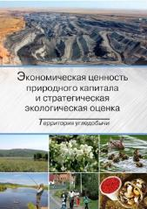
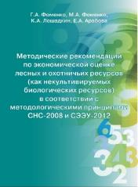
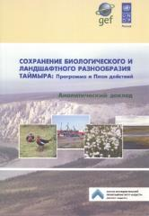
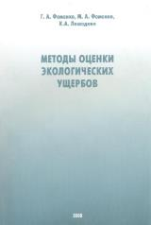
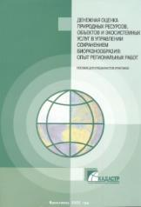
LIBRARY
http://ntc-rik.ru/en/knowledge-center/library/

Slide 4
State report - a system platform for analyzing information in the field of environmental protection
Information resources of federal executive bodies
Information resources of federal districts
Information resources of the executive bodies of subjects of the Russian Federation
Corporate environmental reporting
International statistical databases

Slide 5
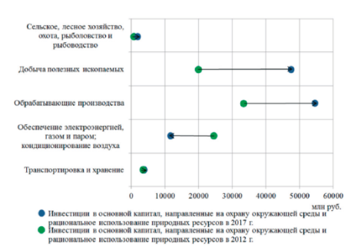
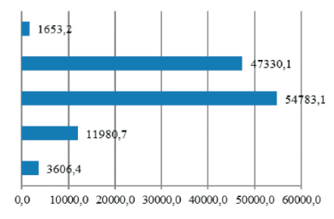
Environmental protection expenditures within the State Report "On the state and protection of environment of the Russian Federation in 2017"
Total investment in fixed assets aimed at environmental protection in the Russian Federation in 2017
Disaggregation of indicators by economic activity
152 996 млн руб.
Dynamics of indicators

Slide 6
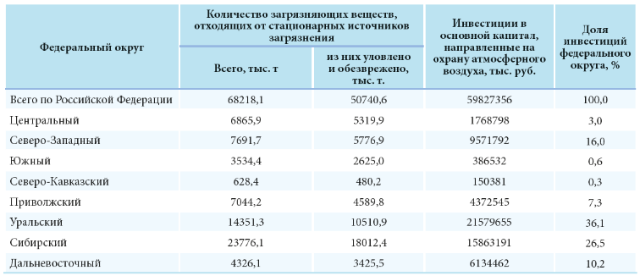
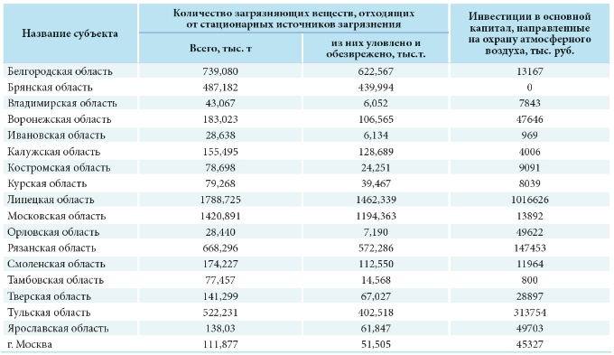
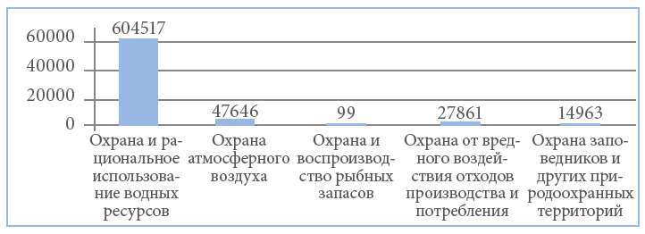
Environmental protection expenditures within the State Report "On the state and protection of environment of the Russian Federation in 2017"
Disaggregation of indicators by territory
Federal Districts
Analysis of the investments efficiency aimed at air protection
Subjects of the Russian Federation
Analysis of the investments efficiency aimed at air protection
Breakdown of investments into environmental protection activities (by subjects of the Russian Federation)

Slide 7
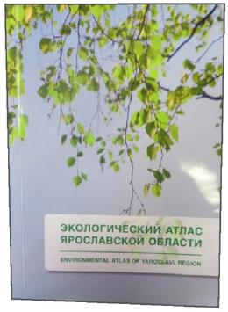
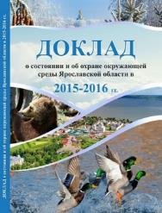
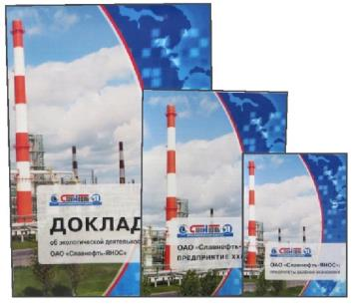
Territorial synthesis of environmental reporting in subject of the Russian Federation
Environmental strategy of subject of the Russian Federation
Ecological Atlas of Territory
1. Environmental state
2. Environmental changes
3. Improving environmental sustainability -
Comparison of environmental expenditures and changes in the environmental situation in the region
Annual reports on the state and protection of environment- Environmental expenditures of budgets
Environmental open
business reporting
According to the Global Reporting Initiative G4 - Environmental Expenditures of Companies

Slide 8
Development of methodology for building a System of economic environmental accounts
Recommendations for the implementation of the methodological approaches of SEEA and foreign experience in the Russian Federation
Development of methodological approaches to the building of an integrated system of environmental economic accounts in physical and monetary terms for the Russian Federation
The results of the analysis of the cells of the SEEA accounts from the point of view of the information supply with official data (statistical and administrative), along with defining the possibility for increasing the information supply
Results of cell analysis regarding methodological elaboration
Development of applied algorithms for building accounts
Results of analysis of official data sources (statistical and administrative) regarding capacity for producing data needed for SEEA
The directions for increasing the information support of SEEA accounts are defined:
- obtaining data that is not currently available;
- interagency interaction / exchange and coordination of information flows
Development of methodological recommendations on the introduction of environmental accounts in the statistical practice of the Russian Federation, in accordance with SEEA 2012
Priority of accounts to be completed is determined, taking into account:
- information safety;
- methodological elaboration;
- relevance
Development of the draft roadmap for the implementation of SEEA accounts in the statistical practice of the Russian Federation
Developed methodological approaches to the accounts compilation (in three groups)
Colors on the diagram indicate the nature of the use of the results of the first stage for obtaining the final results of the project, including for : regulatory methodological (red); information methodological (green); organizational administrative (blue) substantiation

Slide 9
Analysis of available information for compiling accounts as a key element of research
Table - Total national environmental protection expenditures
№ п/п | Наименование показателя | Пользователи |  |  |  |  |  | Итого
 |  | Отрасли |  |  | Домашние хозяйства | Органы государст-венного управления | Некоммер-ческие организа-ции, обслужи-вающие домашние хозяйства
 |  | Производители специализированных услуг по охране окружающей среды |  | Другие производители
 |  | Специализированные производители | Неспециализирован-ные и работающие для собственных нужд производители
 | А | Б | В | Г | Д | Е | Ж | И
13 | Валовое накопление основного капитала | NI
14 | Накопление капитала для характерных видов деятельности | Форма № 18-КС. Сумма значений из графы 2 в строке 01 для респондентов с ОКВЭД 37, ОКВЭД 38 |  |  |  |  |  | Сумма значений в ячейках слева
15 | Перемещения средств на охрану окружающей среды, не учтенные выше | Форма № 4-ОС. Разница значений из графы 3 в строке 01 и графы 4 в строке 01, для респондентов сектора 26 (по данным строки 11) | Форма № 4-ОС. Разница значений из графы 3 в строке 01 и графы 4 в строке 01, для респондентов сектора 25 (по данным строки 11)
16 | Перемещения средств в остальной мир и из остального мира (чистые) | Статистическая форма учета перемещения товаров Федеральной таможенной службы | Статистическая форма учета перемещения товаров Федеральной таможенной службы | Статистическая форма учета перемещения товаров Федеральной таможенной службы |  |  |  | Сумма значений в ячейках слева
Legend: | zero value in accordance with SEEA 2012 | statistical data | administrative data | no statistical and administrative data available

Slide 10
Summarized information on the availability of official data for completion of the environmental protection expenditures (EPE) accounts within SEEA
№ | Parameter name | Value in numbers / in % of the total number of filled cells
 |  | For all SEEA accounts | For EPE accounts
1 | Total number of filled cells, including: | 1154 cells | 124 cells
1.1 | cells, for which official data are available, including: | 576 cells/ 49,8% | 37 cells / 30%
1.1.1 | official statistical information | 332 cells /28,7% | 21 cells /57%
1.1.2 | administrative data | 244 cells / 21,1% | 16 cells / 43%
1.2 | cells, for which official data are not available | 581 cells /50,2% | 87 cells /70%
2 | Availability of official data,% | 576 cells / 49,8% | 37 cells / 30%

Slide 11
Analysis of the sources of statistical data for completion of the environmental protection expenditures accounts within SEEA
1. All official statistical data sources, including: | 9 pcs
1.1 sources used directly for completing account cells | 2
1.2 sources used in the calculations for completing account cells | 7
2. Forms of federal statistical reporting: №4-ОS “Information on operating environmental expenditures”; №18-КS “Information on investments in fixed assets aimed at environmental protection and rational use of natural resources”; №2-ТP (hunting) “Information on hunting”; №1-ООPT “Information on specially protected natural territories”; №1-LH “Information on the forest reproduction and afforestation”; №12-LH “Information on forest protection”; №1-RLH (Chernobyl) “Information on the forest reproduction and afforestation in areas exposed to radioactive contamination”; №5-ОS “Сведения об искусственном воспроизводстве водных биологических ресурсов”; №2-science “Information on research and development”.
3. Number of cells completed using official statistics | 21 cells / 57%

Slide 12
Analysis of administrative data to complete the environmental protection expenditures accounts within SEEA
1. All administrative data sources | 3 pcs
Composed by agencies:
1.1 Federal Forestry Agency (Form 1-subvention "Report on the expenditures of the budget of the subject of the Russian Federation, the source of which is subvention")
1.2 Federal Treasury (Report on the execution of the consolidated budget of the Russian Federation and the budgets of state extra-budgetary funds)
1.3 Federal Customs Service (Statistical form of the Federal Customs Service for accounting of the movement of goods, approved by Decree of the Government of the Russian Federationот of 07.12.2015 № 1329)
2. Sources which data is used directly for completing cells | 2
3. Sources which data is used in performing calculations for completing cells | 1
4. The number of completed cells, the data for which is contained in administrative sources | 16 cells / 43%

Slide 13
The use of official data sources for the determination of indicators for environmental protection expenditures accounts
Indicator name | Source name | Source application format
1. Intermediate consumption for specialist producers of environmental protection services | Form of Federal Statistics No. 4-OS “Information on operating environmental protection expenditures” | Directly
2. Intermediate consumption for non-specialist producers and own-account producers of environmental protection services | 1. Form of federal statistical reporting №2-ТP (hunting) “Information on hunting”; 2. Form of federal statistical reporting №1-ООPT “Information on specially protected natural territories”; 3. Form of federal statistical reporting №1-LH “Information on the forest reproduction and afforestation”; 4. Form of federal statistical reporting №12-LH “Information on forest protection”; 5. Form of federal statistical reporting №1-RLH (Chernobyl) “Information on the forest reproduction and afforestation in areas exposed to radioactive contamination”; 6. Form of federal statistical reporting №5-ОS “Сведения об искусственном воспроизводстве водных биологических ресурсов”; 7. Form of federal statistical reporting №2-science “Information on research and development”. 8. Form 1-subvention "Report on the expenditures of the budget of the subject of the Russian Federation, the source of which is subvention" | To perform calculations

Slide 14
The use of official data sources for the determination of indicators for environmental protection expenditures accounts
Indicator name | Source name | Source application format
3. Remuneration of employees of specialist producers, non-specialist producers and own-account producers as part of the gross value added they receive | Form of federal statistical reporting №4-ОS “Information on operating environmental expenditures” | Directly
4. Gross accumulation of fixed capital of specialist producers, non-specialist producers and own-account producers as a result of providing environmental protection specific services | Form of federal statistical reporting №18-КS “Information on investments in fixed assets aimed at environmental protection and rational use of natural resources” | Directly
5. Taxes less subsidies on production by producers of environmental protection specific services | Report on the execution of the consolidated budget of the Russian Federation and the budgets of state extra-budgetary funds, a sample of the code line 01 for taxes and production subsidies for this type of producer | Directly
6. Transfers to and from the rest of the world by producers of environmental protection specific services | Statistical form of the Federal Customs Service for accounting of the movement of goods, approved by Decree of the Government of the Russian Federationот of 07.12.2015 № 1329 | Directly

Slide 15
Issues for discussion
1. Disaggregation of data on environmental protection expenditures in the Russian statistics does not coincide with that in SEEA.
For example, “commercial and non-commercial”
instead of "state and others."
2. Accounting for household environmental protection expenditures is not provided for in the system of statistical observation.
It is advisable to account household environmental protection expenditures.
3. The available data are sufficient to develop only basic aggregated indicators of environmental expenditure.
How useful and possible is the disaggregation of the available indicators within the existing statistical forms?

Slide 16
Proposals for the order of implementation of SEEA accounts in the statistical practice of the Russian Federation
1. The optimal list should include accounts that have received the highest rating from the results of the analysis, as generally the most information provided, methodologically developed and relevant
2. It is advisable to include the accounts from all three groups (flows in physical terms, accounts of environmental protection activities, assets in physical and monetary terms) in the optimal list
3. When deciding on the order of the introduction of accounts in statistical practice the following should be considered:
how complicated the ways of obtaining official data for completing the cells are;
whether there are possibilities for solving methodological problems of completing the cells and how difficult they are;
how relevant the accounts are at the present time and, most importantly, given the prospects for the development of national accounting in line with international requirements

Slide 17
Thanks for your attention!
info@nipik.ru

